Slide 1

Predicting the likelihood of readmission within 30 days for diabetic patients for hospitals in Singapore
Muhammad Ihsan Bin Mohammad Azmi (U2021160B)
Lim Yan Di (U2010984H)
Lau Shing Hung (U2021155C)
Faith Lee Kai Ling (U2022307C)
Lek Jie Kai (U2021229C)

Slide 2
Table of Contents
Overview
Analytics Approach
02
01
Analytics Solution
Conclusion
03
04
Introduction
Business problem
Business Outcome and Targets
Current Operations
Data Cleaning & Prep
Analytics Approach
False Negative Rate
Logistic Regression (BE)
Neural Network
Random Forest
Evaluation of Models
Limitations
Recommendations
Conclusion
Ihsan

Slide 3

01
Business Problem
Ihsan

Slide 4
Our Target Audience:
Hospitals in Singapore
Ihsan

Slide 5
Singapore’s Healthcare Expenditure
$19.6b
$49b
In 2019
In 2029
Ihsan

Slide 6
Singapore’s Healthcare Expenditure
Identify and reduce unnecessary costs as much as possible
Reduce strain on finite healthcare resources
Ihsan

Slide 7
Singapore’s Healthcare Expenditure
Inpatient costs
One area in healthcare with huge potential costs savings:
Reducing avoidable hospital readmissions
Ihsan

Slide 8
Hospital Readmissions:
The event where a patient is readmitted to the same department within a certain period of time for the same disease
Most commonly used: 30 days
Ihsan

Slide 9
Singapore’s readmission rate
15%
of all the patients discharged from a hospital in Singapore are readmitted within 30 days
Ihsan

Slide 10
Singapore’s High Readmission Rate
By reducing avoidable readmissions:
Frequent admitters are high-cost patients and they contribute to bed shortage
Healthcare expenditure reduced, limited healthcare resources will not be wasted
Patients receive better quality care, reduce financial pressure and psychological stress on patients
Readmission rates are a benchmark of quality for healthcare systems
Ihsan

Slide 11
Focus of project
Diabetes patient readmission
Ihsan

Slide 12
Diabetes in Singapore
400,000
430,000
diagnosed with diabetes in 2021
aged 18-69 diagnosed with pre-diabetes
Ihsan

Slide 13
Diabetes in Singapore
Readmissions of diabetes patients due to non-diabetes causes have been on the rise.
Important to provide support to diabetes patients.
Reduce their hospital readmission rates through proper care.
Ihsan

Slide 14

Current operations
Measures put in place to tackle the issue
Ihsan

Slide 15

Services
Current operations
Prediction tools
Patient education
Lipid management
Web-based prediction tool (NUS)
Predicted risk of 15-day readmission and facilitate targeted interventions
Accuracy rate of about 65%.
GEMINI (NUS)
Predicted chance of readmission and risk factors for readmission.
Issue: Aimed at patients in general, not diabetic patients.
Ihsan

Slide 16
Services
Current operations
Prediction tools
Patient education
Lipid management
Model of care (Changi General Hospital)
Health Management Unit (HMU) created by CGH.
Address gaps in diabetes care through patient education.
Telehealth service; tele-nurses periodically call patients to:
Educate them (Dietary advice, lifestyle improvements etc)
Collect and monitor clinical markers for early intervention
Collected information condensed into summary for doctor’s use.
Ihsan

Slide 17
Services
Current operations
Prediction tools
Patient education
Lipid management
Statin therapy
Diabetes patients have higher risk of CVD.
Statins usually prescribed to counter these conditions.
Myths surrounding statin use (Muscle aches, liver damage etc).
Fall in adherence in the long term.
Organisations such as AVHC and NHC started awareness efforts.
Ihsan

Slide 18
Services
Current operations
Prediction tools
Patient education
Lipid management
Current operations aimed at holistically improving quality of care
More can be done to apply analytics to diabetic patients to complement/ enhance existing measures
Ihsan

Slide 19
Problem statement
Underlying sub-problems and implications
Ihsan

Slide 20
Problem statement
Fall in quality of care
Suboptimal use of resources
Ihsan

Slide 21
Problem statement
Fall in quality of care
Suboptimal use of resources
↑ readmission rates → ↑higher volume of patients.
COVID-19; Healthcare workers (HCWs) severely overworked.
Hospitals consistently working at full capacity.
High resignation rate of HCWs.
Not enough manpower to properly manage patients.
Note: Counter measures also require additional manpower.
Ihsan

Slide 22
Problem statement
Fall in quality of care
Suboptimal use of resources
Resource wasted on readmissions.
Costs more to accommodate for readmissions than to give higher care during first visit.
Spend more on patients in the present to avoid unnecessary costs in the future.
Note: Ideally only high risk patients receive additional attention.
Ihsan

Slide 23
Overarching questions:
1. How can we predict whether a patient is likely to be readmitted based on their profile and current clinical markers?
2. How can we predict whether a patient is likely to be readmitted based on their profile and current clinical markers?
Ihsan

Slide 24
Business Problem:
“Predict likelihood of hospital readmission of diabetic patients in Singapore, for hospitals to selectively implement preemptive measures to reduce their readmission risk, reducing costs incurred”
Ihsan

Slide 25
Business outcome targets
Assessing/Measuring the strength of our project
Ihsan

Slide 26
Business outcome targets
Testset performance
Split data into train and test sets.
Model created using train set and assessed using test set.
Need to pay attention to False Negative Rate (FNR), indicates chance of misclassifying high risk patient.
Actual outcomes/improvements
Apply model to current data and checking performance.
If results are good, can use results to selectively apply measures on patients.
Measure change in readmission rates and costs of hospital over time.
Ihsan

Slide 27

02
Analytics Approach
Lim Yan DI

Slide 28
Data Source
Over 101,766 patient records
Diabetic Patients
Across 130 hospitals in USA
Collected over 10 years (1999-2008)
49 features of patient data
Includes outcome of hospital stay
Readmission <30 days
Readmission >30 days
Not readmitted
Lim Yan Di

Slide 29
Data Cleaning
Selected 20 out of 49 patient features
Rows with NA or missing values removed
admission_source_id
5: not available
6: null
8: not mapped
admission_type_id
9, 15: not available
17: NULL
20: not mapped
21: unknown / invalid
For categorical variables: rows with values outside the specified range (given in data dictionary) were removed
3 rows for “unknown/invalid” gender were removed
Lim Yan Di
Notes:
QnA might ask why we remove instead of replacing: had a lot of data ? not useful to replace with mode or median or mean

Slide 30
Data Preparation
All categorical variables changed to factor type
Choosing the top 5 most used medicines from the 24 in the dataset
Reclassifying the categories for our “readmitted” variable to binary
>30 days and no: 0
<30 days: 1
Normalisation of continuous variables
Train-test split: 90/10 ratio
Balancing data in trainset by sampling from the majority
Results
Trainset: 18224 rows
Testset: 9021 rows
Lim Yan Di

Slide 31
Dashboard
Lim Yan Di

Slide 32
Our Goal:
Develop a reliable method to accurately determine the likelihood of readmission of diabetic patients within 30 days of their discharge, based on their previous data and clinical markers.
Lim Yan Di

Slide 33
Comparing 3 Models
Logistic Regression (BE)
Neural Network
Random Forest
Using all variables
Using statistically significant variables identified from Logistic Regression
Using all variables
All 3 models will be compared using false negative rate.
Lim Yan Di

Slide 34
False Negative Rate
 |  | Predicted
 |  | Will not be readmitted within 30 days | Will be readmitted within 30 days
Actual | Will not be readmitted within 30 days
 | Will be readmitted within 30 days
A
B
FNR = A / (A+B )
Lim Yan Di

Slide 35
Impacts of FNR
For hospitals:
Frequent failure to predict a case → increase in preventable readmissions
Increased in-patient costs, drives hospital expenditure up
Strain on hospital resources
Damaged reputation
For the patients:
Not getting the care they need the first time
Cause further health complications / their condition worsens
Greater financial burden due to multiple hospital visits
Readmitted patients often return with higher severity of illness
→ even higher cost of treatment for hospital + harmful to patient
Lim Yan Di

Slide 36

03
Analytics Solution
Lau Shing Hung

Slide 37
Logistic Regression
Lau Shing Hung

Slide 38
Logistic Regression
A statistical analysis method to predict a binary outcome based on prior observations of a data set.
Whether a patient is readmitted within 30 days
With Backward Elimination
Lau Shing Hung

Slide 39


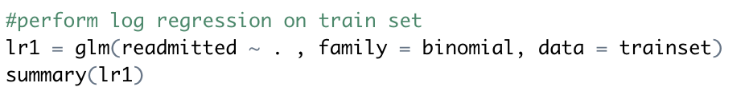

Split the dataset into trainset and testset with a 90:10 ratio.
Logistic Regression
Perform Logistic Regression on the trainset.
Simplified Steps to predict readmitted status
Check for multicollinearity between variables by running vif. If GVIF > 5 for the variables, it suggests multicollinearity.
Lau Shing Hung

Slide 40


Backward elimination to select variables for best-fit logistic regression model with step().
Categorical | A1Cresult, diabetesMed, insulin, metformin, glyburide
Numeric | Time_in_hospital, num_procedures, num_medications, number_emergency, number_inpatient, number_diagnoses
Logistic Regression
Simplified Steps to predict readmitted status
The resulting Logistic Regression model will then be used to predict the patient’s readmitted status.
Lau Shing Hung

Slide 41
Confusion Matrix of Logistic Regression with BE
 |  | Predicted |  | Class Error
 |  | Not readmitted within 30 days | Readmitted within 30 days
Actual | Not readmitted within 30 days | 5496 | 2512 | FPR | 31.4%
 | Readmitted within 30 days | 493 | 520 | FNR | 48.7%
Overall Accuracy |  | 66.7%
Lau Shing Hung

Slide 42
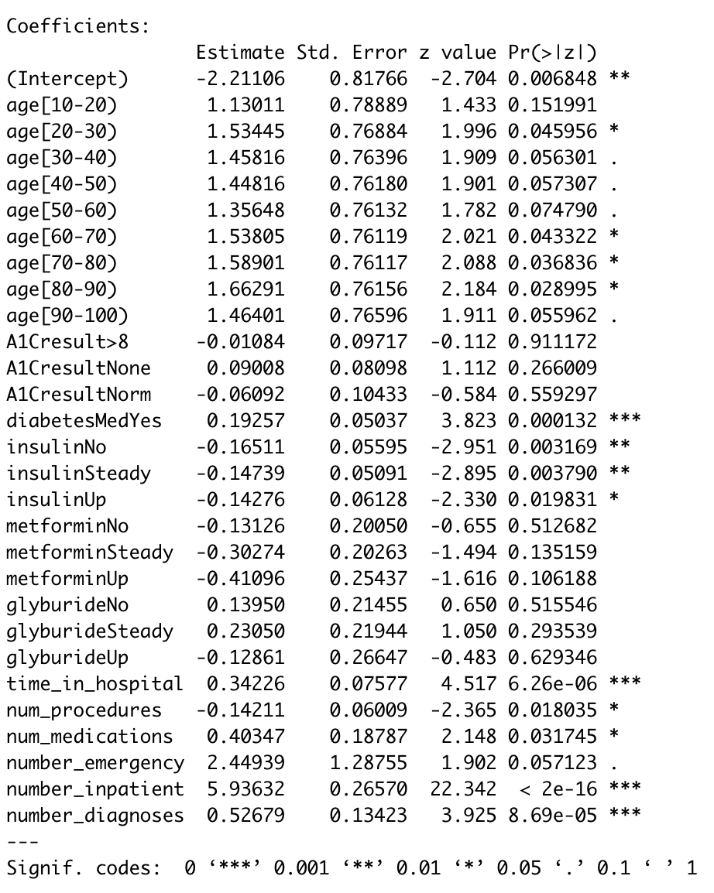
Significant Variables identified for Neural Network
Statistically significant variables identified using P-value < 0.1
Significant variables to be fit into Neural Network
age | Categorical
diabetesMed | Categorical
insulin | Categorical
num_procedures | Continuous
num_medications | Continuous
number_emergency | Continuous
number_inpatient | Continuous
number_diagnoses | Continuous
Lau Shing Hung

Slide 43
Neural Network
Lau Shing Hung

Slide 44
Neural Network
Significant Independent variables are identified from Logistic Regression and fit into Neural Network, forming the input layer.
The number of hidden layers and number of hidden nodes in the respective hidden layers can be set, forming the hidden layers.
Output layer of the Neural Network will be whether the patient is readmitted early.
Lau Shing Hung

Slide 45
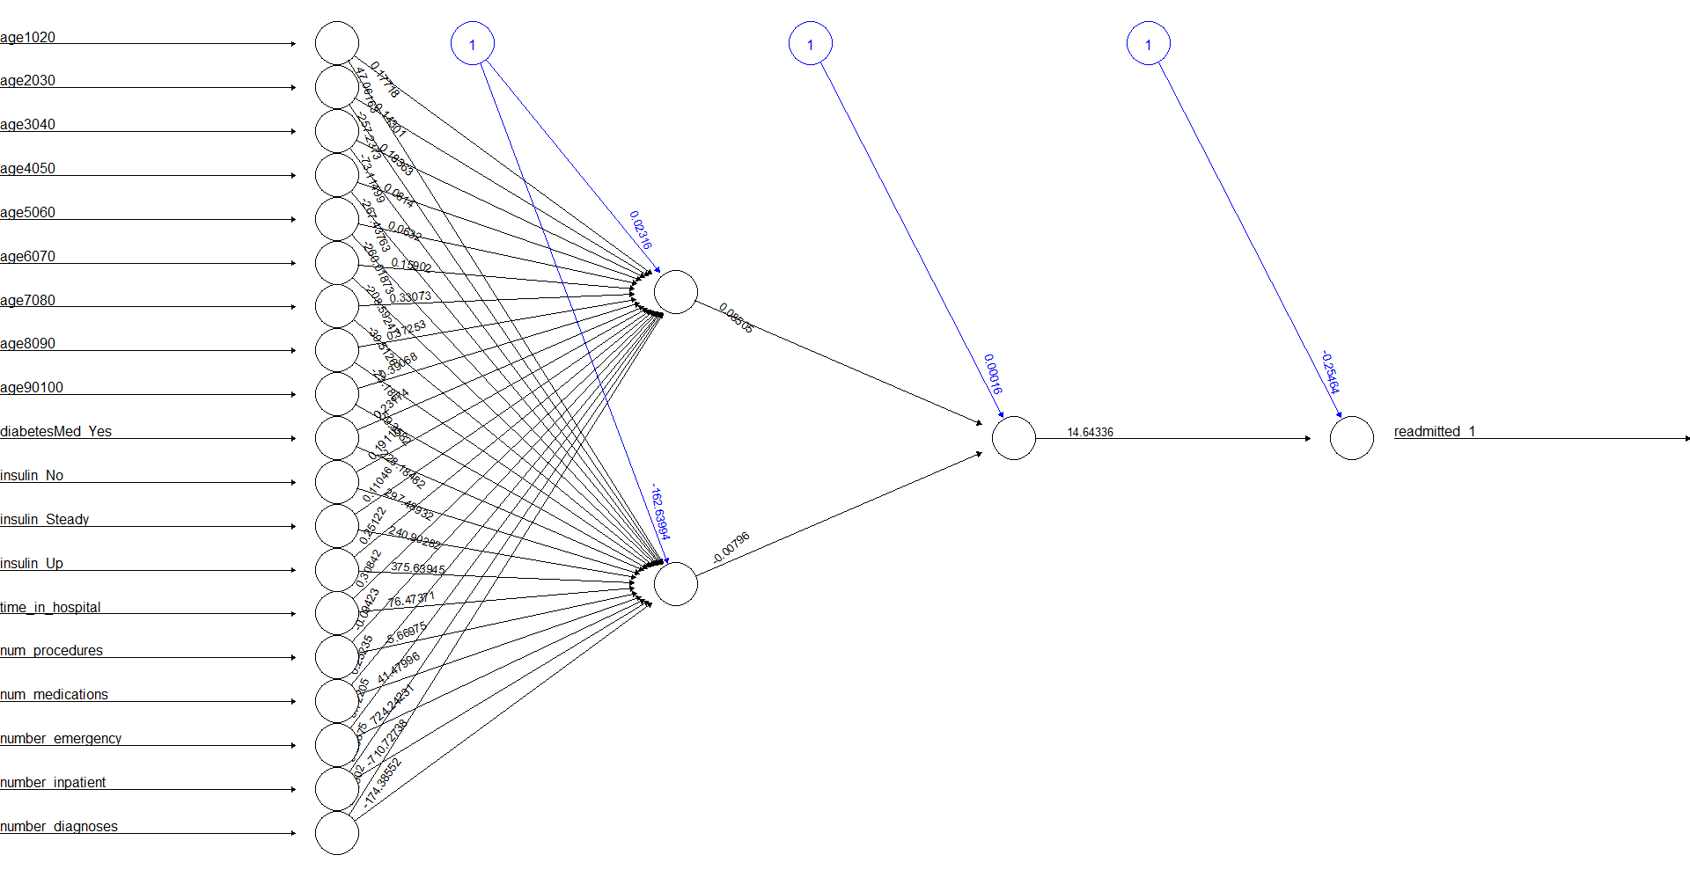
Input Layer
First Hidden Layer
Second Hidden Layer
Output Layer
Lau Shing Hung

Slide 46
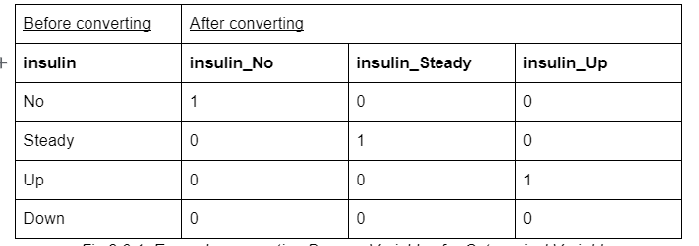
Create dummy variables for the categorical variables.
Neural Network
Simplified Steps to predict readmitted status
Initialize the Neural Network. Set number of hidden layers and hidden nodes. All paths will be randomly assigned weights.
Lau Shing Hung

Slide 47
Receiving nodes of the Hidden layers and lastly, the output node processes the weighted sum of information from the incoming nodes via an activation function (tanH).
Neural Network
The weights are then revised by the Neural Network model to optimal values via backpropagation.
Simplified Steps to predict readmitted status
Using the new optimal weights, we can then determine the predicted value of readmitted.
Lau Shing Hung

Slide 48
4 tests with different values of hidden layers and hidden nodes within the layers.
 | False Positive Rate | False Negative Rate | Overall Model Accuracy
1 hidden layer with 2 hidden nodes | 35.7% | 44.3% | 63.4%
1 hidden layer with 1 hidden node | 36.3% | 42.8% | 62.9%
2 hidden layers, 2 hidden nodes in 1st layer, 1 hidden node in 2nd hidden layer | 39.9% | 41.0% | 59.9%
2 hidden layers, 1 hidden node per layer | 36.8% | 43.1% | 62.5%
Lau Shing Hung

Slide 49
Confusion Matrix of the optimal Neural Network model
2 hidden layers 2 hidden nodes in 1st layer 1 hidden node in 2nd hidden layer |  | Predicted
 |  | Not readmitted within 30 days | Readmitted within 30 days | Class Error
Actual | Not readmitted within 30 days | 4809 | 3199 | FPR | 39.9%
 | Readmitted within 30 days | 415 | 598 | FNR | 41.0%
Overall Accuracy |  | 59.9%
Lau Shing Hung

Slide 50
Random Forest

Slide 51
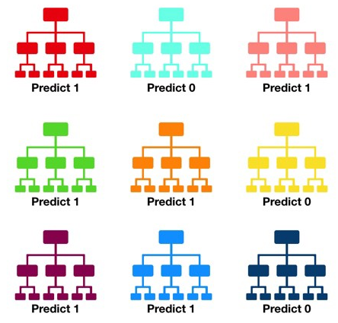
What is random forest?
A large number of decision trees used to predict an outcome
Reduced overfitting + reduced variance = Improved accuracy
Faith
Analytics Solution: Random Forest

Slide 52

How it works
Bootstrap
Aggregation
Data is sampled with replacement from the whole, original dataset
Creating bootstrapped sample of size equal to the size of the original dataset
A case could appear more than once, or not at all in the bootstrapped dataset
Each tree in the random forest hence trained on a slightly different set of data
Faith
Analytics Solution: Random Forest

Slide 53
How it works
– Bagging
Bootstrap
Aggregation
Multiple decision trees are created
Prediction of each tree is aggregated → each tree hence constitutes a ‘vote’ for a certain prediction
The majority vote forms the prediction of random forest model
Bootstrap + Aggregation = Bagging
Faith
Analytics Solution: Random Forest

Slide 54
Random forest consists of many differing trees
Bootstrapped Samples
Random Subset Feature Selection
At each split of the decision trees, only a subset of predictor variables are chosen candidates for that particular split
The size of that subset is called the random subset feature (RSF) size, and can be user-specified
Ensures that every tree is slightly different
Offering different ‘perspectives’ on what the predicted outcome should be
Hence, many trees are needed to accurately obtain the best prediction
Faith
Analytics Solution: Random Forest

Slide 55
Train random forest model on train set using all predictor variables
Random Forest
Model trained with the following parameters:
Parameter | Value
Number of trees (‘ntree’) | 500
Random subset feature size (‘mtry’) | 4
Simplified Steps to predict readmitted status
Out-of-bag (OOB) error of 41.1% attained
Model used to predict on test set data
Faith
Analytics Solution: Random Forest

Slide 56
Initial model results on test set
Train set FNR = 41.1%
 |  | Predicted |  | Class Error
 |  | Not readmitted within 30 days | Readmitted within 30 days
Actual | Not readmitted within 30 days | 4863 | 3142 | FPR | 39.3%
 | Readmitted within 30 days | 428 | 584 | FNR | 42.3%
Overall Accuracy |  | 60.4%
Higher FNR than the optimal neural network model
We decided to further refine the random forest model by trying different variables and tuning the hyperparameters
Faith
Analytics Solution: Random Forest

Slide 57
Refined model results on test set
Train set FNR = 41.4%
 |  | Predicted |  | Class Error
 |  | Not readmitted within 30 days | Readmitted within 30 days
Actual | Not readmitted within 30 days | 4679 | 3327 | FPR | 41.6%
 | Readmitted within 30 days | 406 | 606 | FNR | 40.4%
Overall Accuracy |  | 58.6%
Using RSF size ‘mtry’ = 8
FNR is slightly lowered
The model is likely to wrongly predict that a patient will not be readmitted 40.4% of the time
Faith
Analytics Solution: Random Forest

Slide 58
Strengths & Limitations of Logistic Regression
Least amount of computational power needed of the three techniques
Automatically creates dummy variables
Able to identify statistically significant variables with p-value
Resulting model is easy to interpret and apply
Can determine how much a variable affects the outcome (normalised data)
Can also determine if the variable’s impact on the outcome is positive or negative
Strengths
Assumes linear relationship between independent and dependent variables
Have to normalise the numeric variables in order to determine variable importance
Hard to obtain complex relationships, unlike more powerful algorithms such as neural network
Limitations
Faith
Analytics Solution: Techniques Review

Slide 59
Strengths & Limitations of Neural Network
Able to model complex relationships
Neural networks are able to approximate any continuously differentiable function, which is unlike almost any other machine learning algorithm
Unique in that aspect
Can determine how much a variable affects the outcome (normalised data)
Can also determine if the variable’s impact on the outcome is positive or negative
Strengths
Most amount of computational power required to be train neural network
Requires significantly more amount of data to be trained, in order to learn the abstract representations of the dataset
Unable to identify important or significant variables, unless numeric data is normalised and there is no multicollinearity
Black box model → hard for humans to interpret, difficult to gain insights of the structure of the data through neural network
Limitations
Faith
Analytics Solution: Techniques Review

Slide 60
Strengths & Limitations of Random Forest
Easy to implement
Automatically creates dummy variables
Default parameters generally perform well already
In-house functionality of deriving variable importance, unlike the other two techniques
Assumption of non-linearity not required
Strengths
More computational power needed to build numerous trees, results not instant
Disadvantage when trying to tune hyperparameters
Hard to interpret the resulting model, because it consists of numerous decision trees
Cannot be visualised in that sense
Limitations
Faith
Analytics Solution: Techniques Review

Slide 61
Evaluation of Models
Jie Kai

Slide 62
Overview of Evaluation Process
Stage 1: Overall Accuracy
Stage 2: Precision Rate, Recall Rate,F1 score
Stage 3:
False Negative Rate
Conclusion
on Optimal Model
3 stages as it is insufficient to make a conclusion solely based on overall accuracy
Jie Kai

Slide 63
Stage 1: Overall accuracy using Confusion Matrix
A technique for summarizing the performance of a machine learning model
Able to calculate the classification accuracy through confusion matrix
 |  | Predictions
 |  | Not readmitted | Readmitted within 30 days
Actual Results | Not readmitted | A% (True Negative) | B% (False Positive)
 | Readmitted within 30 days | C%(False Negative) | D% (True Positive)
Overall Accuracy(Classification Accuracy) = A% + D%
A% + B% + C% + D% = 100%
Jie Kai

Slide 64
Comparison of overall accuracy across 3 models
Logistic Regression (Testset)
 |  | Predictions
 |  | Not readmitted | Readmitted within 30 days
Actual Results | Not readmitted | 60.9% | 27.8%
 | Readmitted within 30 days | 5.5% | 5.8%
Observation:
Overall Accuracy = 60.9% + 5.8% = 66.7%
Jie Kai

Slide 65
Comparison of overall accuracy across the models
Neural Network (Testset)
 |  | Predictions
 |  | Not readmitted | Readmitted within 30 days
Actual Results | Not readmitted | 53.3% | 35.5%
 | Readmitted within 30 days | 4.6% | 6.6%
Observation:
Overall Accuracy = 53.3% + 6.6% = 59.9%
Neural Network produce a lower accuracy than Logistic Regression
Jie Kai

Slide 66
Comparison of overall accuracy across the models
Random Forest (Testset)
 |  | Predictions
 |  | Not readmitted | Readmitted within 30 days
Actual Results | Not readmitted | 51.9% | 36.9%
 | Readmitted within 30 days | 4.5% | 6.7%
Observation:
Overall Accuracy = 51.9% + 6.7% = 58.6%
Random Forest has a slightly lower overall accuracy than neural network.
Jie Kai

Slide 67
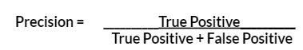
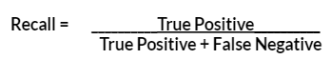
Stage 2: Precision Rate & Recall Rate
Precision Rate:
Indicates proportion of positive predictions that was correctly predicted.
For patients predicted to be readmitted, how many of them were predicted correctly?
Recall Rate (Sensitivity):
Indicates proportion of actual positives that was correctly identified
For patients that are actually readmitted, how many of them were predicted correctly?
Jie Kai

Slide 68
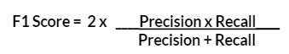
Stage 2: F1 Score
F1 Score:
Weighted average of Precision and Recall Rates
More useful measure than overall accuracy especially for datasets with uneven class distribution (because it takes into account both false positive and false negatives)
Our dataset (test set) has uneven class distribution → F1 score will give a more accurate measure of model’s accuracy if dataset is not balanced
Jie Kai

Slide 69
Comparing Recall Rate, Precision Rate and F1 Score across the models
Model | Precision | Recall | F1 Score
Logistic Regression | 17.2% | 51.3% | 25.6%
Neural Network | 15.8% | 59% | 24.8%
Random Forest | 15.4% | 59.9% | 24.5%
Observation:
Neural Network and Random Forest (having similar scores) have a lower precision but a higher recall rate than Logistic Regression
Logistic Regression has a slightly higher F1 score than the other models.
Difficult to make a conclusion on which model is the most optimal
Jie Kai

Slide 70
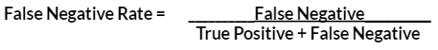
Stage 3: False Negative Rate (Miss Rate)
Model predicts patient will not be readmitted but the patient was actually readmitted.
 |  | Predictions
 |  | Not readmitted | Readmitted within 30 days
Actual Results | Not readmitted | True Negative | False Positive
 | Readmitted within 30 days | False Negative | True Positive
Jie Kai

Slide 71
Comparison of False Negative Rate across the models
Model | False Negative Rate
Logistic Regression | 48.7%
Neural Network | 41%
Random Forest | 40.4%
Observation:
Random Forest model has the lowest False Negative Rate
Preliminary Conclusion: Random Forest is the most optimal as it is crucial to have low false negative rate.
Jie Kai

Slide 72
Conclusion: Most optimal model to be used
Model | Overall Accuracy | Precision | Recall | F1 Score | False Negative Rate
Logistic Regression | 66.7% | 17.2% | 51.3% | 25.6% | 48.7%
Neural Network | 59.9% | 15.8% | 59% | 24.8% | 41%
Random Forest | 58.6% | 15.4% | 59.9% | 24.5% | 40.4%
Observation
Random Forest has a slightly lower False Negative Rate than the Neural Network Model.
Precision Rate, Recall Rate and F1 score are comparable to the other models
Random Forest is recommended as it can provide important variables affecting readmission
Jie Kai

Slide 73
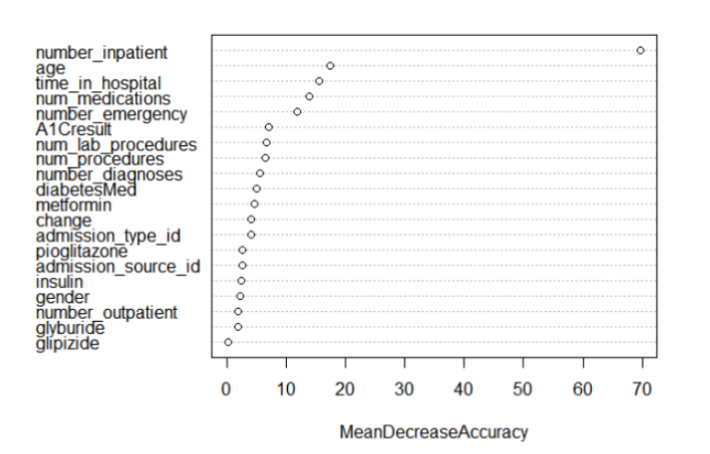
Variable Importance of the Random Forest Model
Top 3 important variables identified are “number of inpatient visits”, age and “time in hospital”.
Direct more medical attention and resources to these areas.
Jie Kai

Slide 74

04
Conclusion
Jie Kai

Slide 75
Limitations of Analysis
Dataset based on past data of diabetic patient is from hospitals in the USA
May not be applicable to diabetic patients in Singapore hospitals
Variables deemed significant to patients in the USA may not be significant to patients in Singapore
Readmission rate may also be affected by factors other than the independent variables used for prediction in our models
Dependent variable only focus on whether the patient was readmitted
Dataset has no variables on the frequency of a patient’s readmission within 30 days
Patients with higher frequency of readmission require more medical attention from the hospital which may go undetected.
Jie Kai

Slide 76

Recommendations for Chosen Model
Customise the Random Forest Model for each hospital
Obtain Singapore or hospital specific data on diabetic patient and feed them into the model for each patient
Data on the frequency of readmission within 30 days to be considered by the model to allocate constrained medical attention and resources to patients who are readmitted more frequently
Jie Kai

Slide 77
Conclusion
Hospitals have limited manpower and resources
Developed machine learning models help to predict if a diabetic patient will be readmitted within 30 days
Evaluated 3 machine learning models and recommended the Random Forest model.
Helps hospitals to direct medical attention and resources to patients who needs it most to reduce strain on finite healthcare resources
Jie Kai

Slide 78
Thank you!

Slide 79
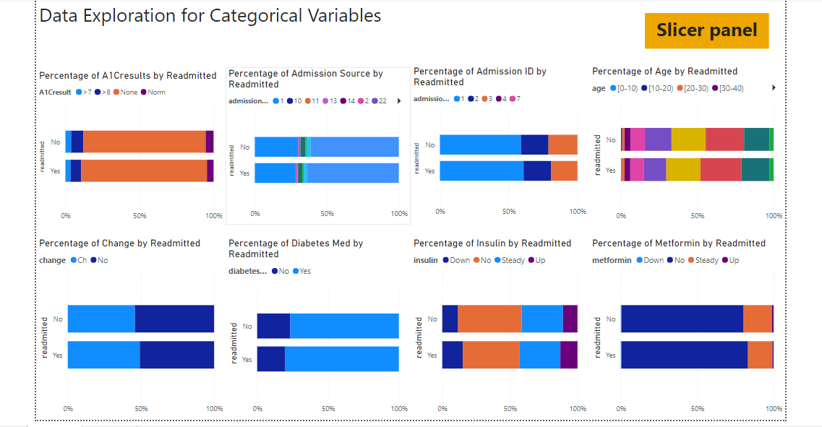
Appendix (Dashboard)

Slide 80
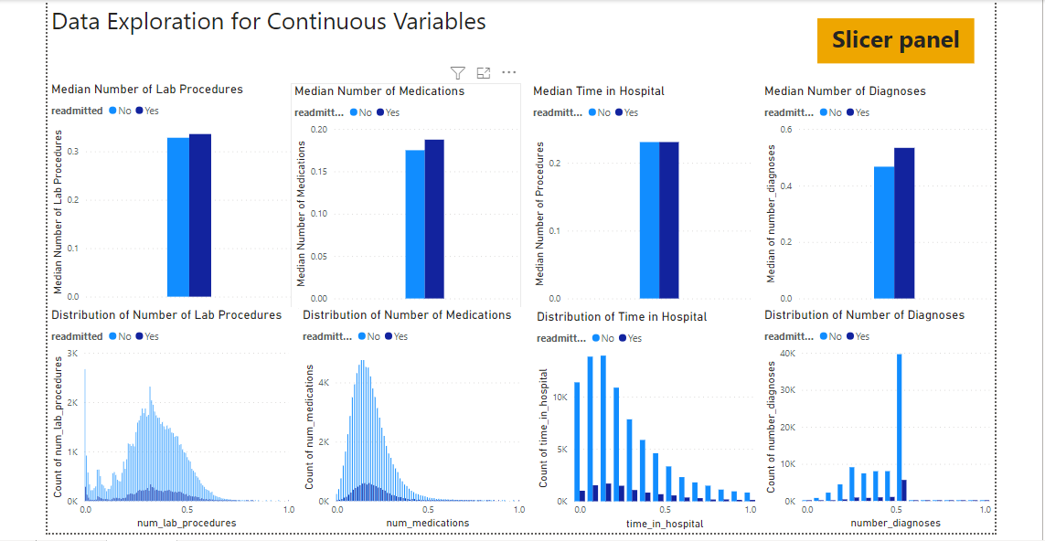
Appendix (Dashboard)

Slide 81
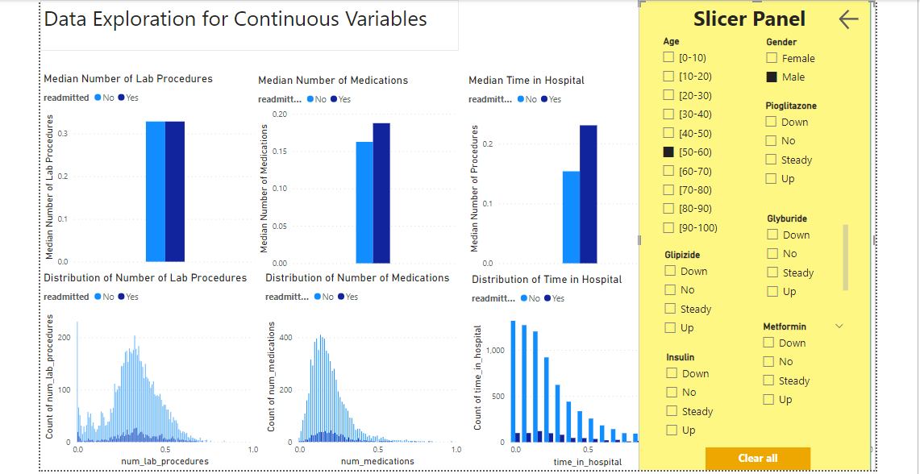
Appendix (Dashboard)

Slide 82
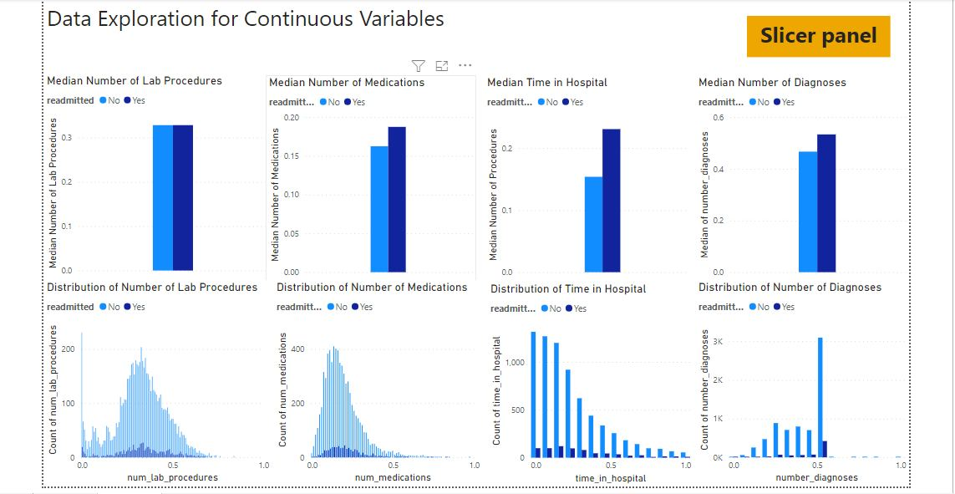
Appendix (Dashboard)

